Slide 1
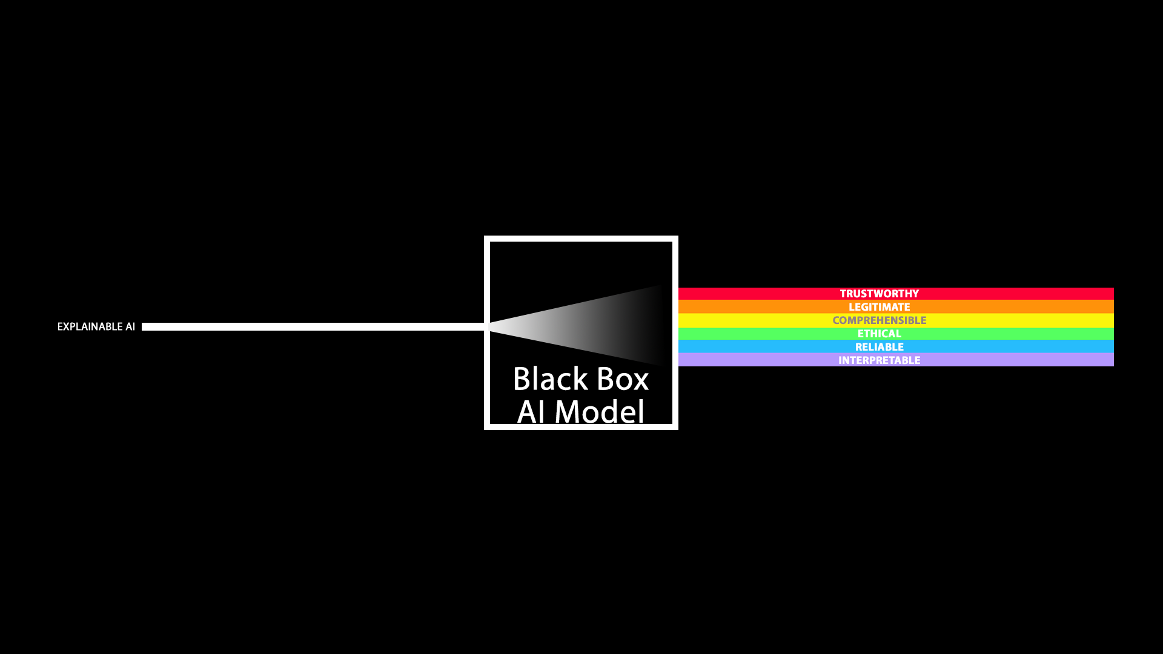

Explainable AΙ – Interpretable ML
Ioannis Mollas, iamollas@csd.auth.gr, PhD Student Supervisors: Nick Bassiliades, Grigorios Tsoumakas

Slide 2








AI APPLICATIONS
AI Model
ECOA

Slide 3















Hello this is not a useful piece of text, but I would like to use it for a text summarization example of interpretable machine learning, which is a subfield of explainable machine learning. Made by John Mollas for NeHuAI20
Self Driving
Water Waste
Text Summarization
Assist Bail System
AI APPLICATIONS
Credit Score
Fall Detection
Drug Design
Robotic Assistant
Security
Data Analysis
Prescriptive Maintenance
Personalized
Medication
Natural Disaster
Heart Disease
Automated Recruitments
GDPR Complaint AI

Slide 4
XAI
Explainable AI (XAI) refers to methods and techniques in the applications of artificial intelligence such that will shed light to reasons of the decision-making of such systems
Hello this is not a useful piece of text, but I would like to use it for a text summarization example of interpretable machine learning, which is a subfield of explainable machine learning. Made by John Mollas for NeHuAI20
Self Driving
Water Waste
Text Summarization
Assist Bail System
AI APPLICATIONS
Credit Score
Fall Detection
Drug Design
Robotic Assistant
Security
Data Analysis
Prescriptive Maintenance
Personalized
Medication
Natural Disaster
Heart Disease
Automated Recruitments
GDPR Complaint AI

Slide 5
What we want to tackle or achieve with XAI?
Real case examples
Tackle
Gender biases
Racial and religious discrimination
Data errors and misclassifications
Loss of life
Acquisition of new knowledge
Robust systems
Trustworthy systems
Achieve

Slide 6
Real case examples
”Google Translate automatically chooses the gender for you”

Slide 7
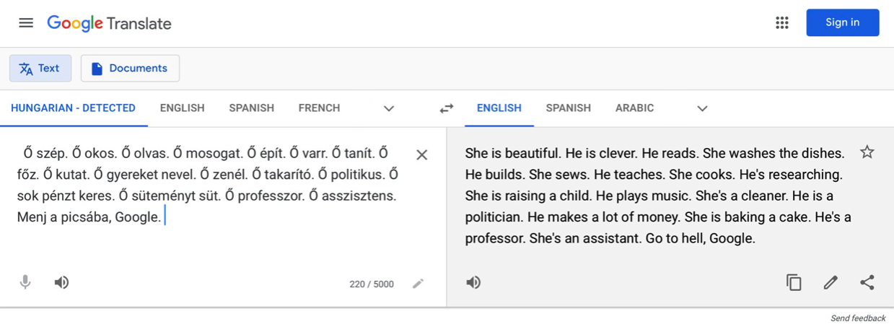
Real case examples
”Google Translate automatically chooses the gender for you”
]
Source: https://twitter.com/DoraVargha/status/1373211762108076034?s=20
Related Publication: https://link.springer.com/article/10.1007/s00521-019-04144-6

Slide 8
Real case examples
”Google Translate automatically chooses the gender for you”
“Inappropriate patient treatments by Watson AI”

Slide 9
Real case examples
”Google Translate automatically chooses the gender for you”
“Inappropriate patient treatments by Watson AI”
“Trippy T-Shirt Makes You Invisible to AI”

Slide 10
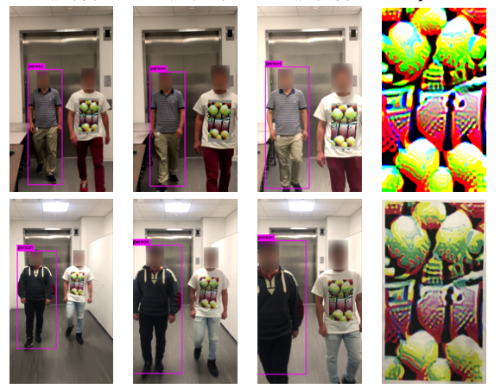
Real case examples
”Google Translate automatically chooses the gender for you”
“Inappropriate patient treatments by Watson AI”
“Trippy T-Shirt Makes You Invisible to AI”
Source: https://www.vice.com/en/article/evj9bm/adversarial-design-shirt-makes-you-invisible-to-ai
Related Publication: https://arxiv.org/pdf/1910.11099.pdf

Slide 11
Real case examples
”Google Translate automatically chooses the gender for you”
“Inappropriate patient treatments by Watson AI”
“Trippy T-Shirt Makes You Invisible to AI”
“Google Allo suggested man in turban emoji as response to a gun emoji”

Slide 12
Real case examples
”Google Translate automatically chooses the gender for you”
“Inappropriate patient treatments by Watson AI”
“Trippy T-Shirt Makes You Invisible to AI”
“Google Allo suggested man in turban emoji as response to a gun emoji”
“Facebook Enabled Advertisers to Reach ‘Jew Haters’”

Slide 13
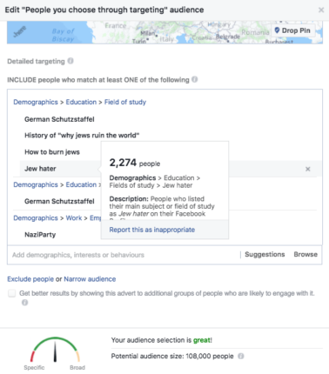
Real case examples
”Google Translate automatically chooses the gender for you”
“Inappropriate patient treatments by Watson AI”
“Trippy T-Shirt Makes You Invisible to AI”
“Google Allo suggested man in turban emoji as response to a gun emoji”
“Facebook Enabled Advertisers to Reach ‘Jew Haters’”
Source: https://www.propublica.org/article/facebook-enabled-advertisers-to-reach-jew-haters

Slide 14
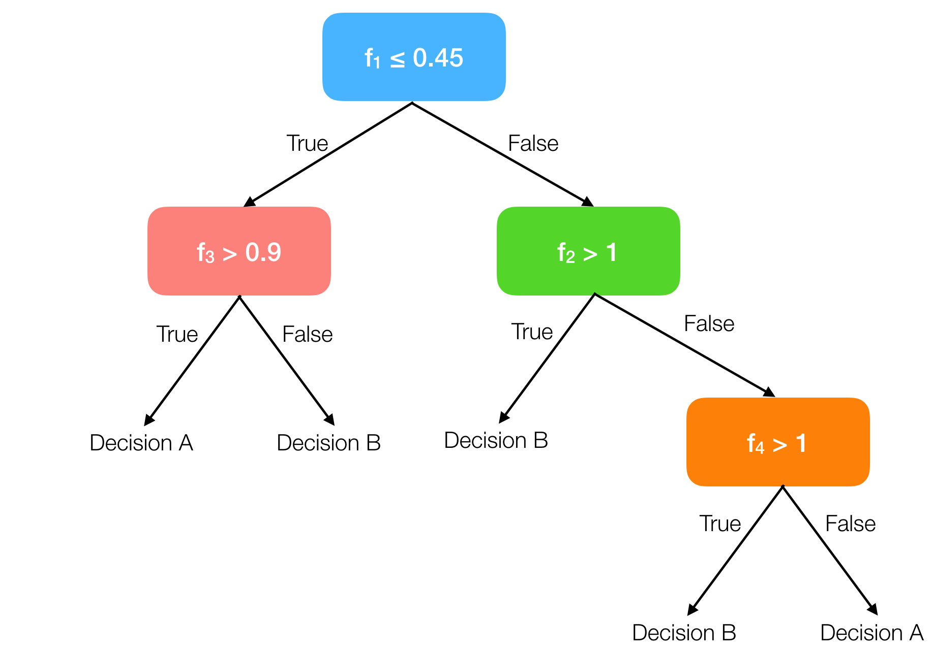








What about IML?
Interpretable ML (IML) refers to the ability of machine learning models to justify their decisions in a way people understand.
Few machine learning model, which are either transparent or black boxes
Regression Model: $f\left(x1\right)= w1x1 +bias$
Decision Tree: $if f1≤0.45 and$
$$f3>0.9 then Decision A$$
Random Forests: ?
Neural Network: ?
#transparentModel
#transparentModel
#blackBoxModel
#blackBoxModel

Slide 15
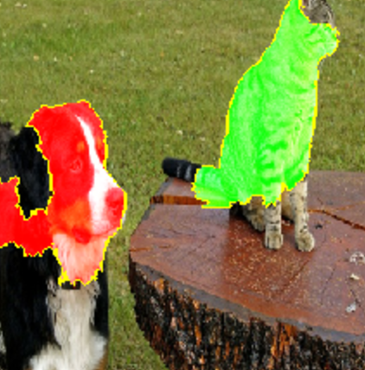
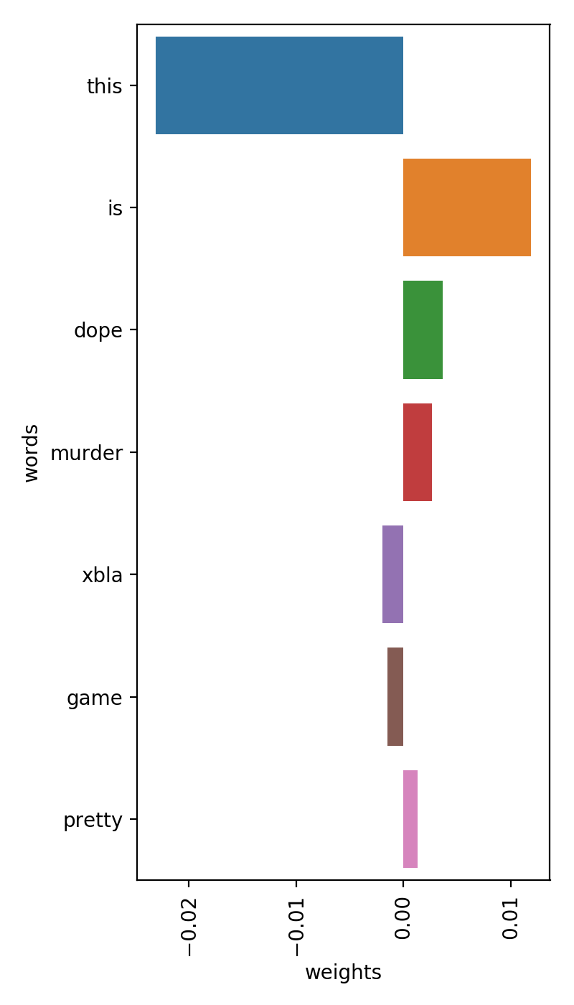
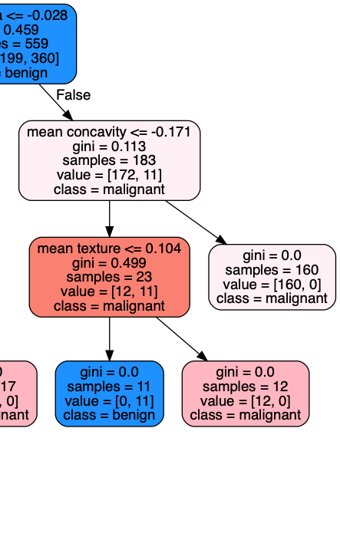
Shape of Interpretations
IF Proline>=990.0 THEN Wine=1
IF Color intensity<=3.85 AND Color intensity<=3.52 THEN Wine=2
IF Flavanoids<=1.41 AND Proline>=470.0 THEN Wine=3
IF Proline>=680.0 AND Alcohol>=12.93 THEN Wine=1
IF Hue>=0.69 THEN Wine=2
IF TRUE THEN Wine=2
Why did you predict that?
Because of $Arg0$
Attacking Arg1
Attacking Arg3
”You were classified as cat because you have pointy ears :)”
But this $Arg1$ is valid too!
That’s true, but $Arg2$ defends $Arg0$!
Textual Form
Visual Form
Graphical Form
Dialectical Form

Slide 16
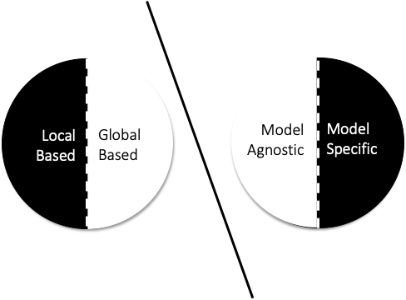
Dimensions of Interpretability Techniques

Slide 17
But what if we want to interpret a black box model?

Slide 18

This is a black box
Decision
Decisions
(dependent variables)
Input Data:
(in)dependent variables
Data without
dependent variables
This is a transparent model

Slide 19


Our work
Find most of our work in our github repositories:
https://git.io/JOqkQ
https://git.io/JOqk7
Interpreting Neural Networks (LioNets, AutoLioNets, LioNets V2)
Interpreting Random Forests (Preliminary LionForests, LionForests, LionForests Bot)
Interpreting Predictive Maintenance Models (VisioRed)
Altruist
Argumentative Explanations & Truthfulness Evaluation (Altruist)

Slide 20
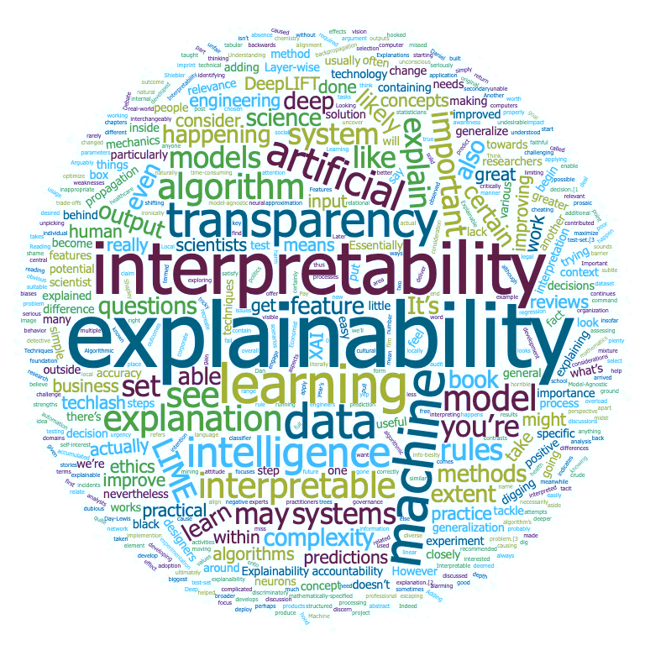

Demo Time

Slide 21
The End
Ioannis Mollas
These resources here:
https://git.io/JOr3l
Git Repository
“Magic model on the core,
Explain yourself in front of all”

